Slide 1




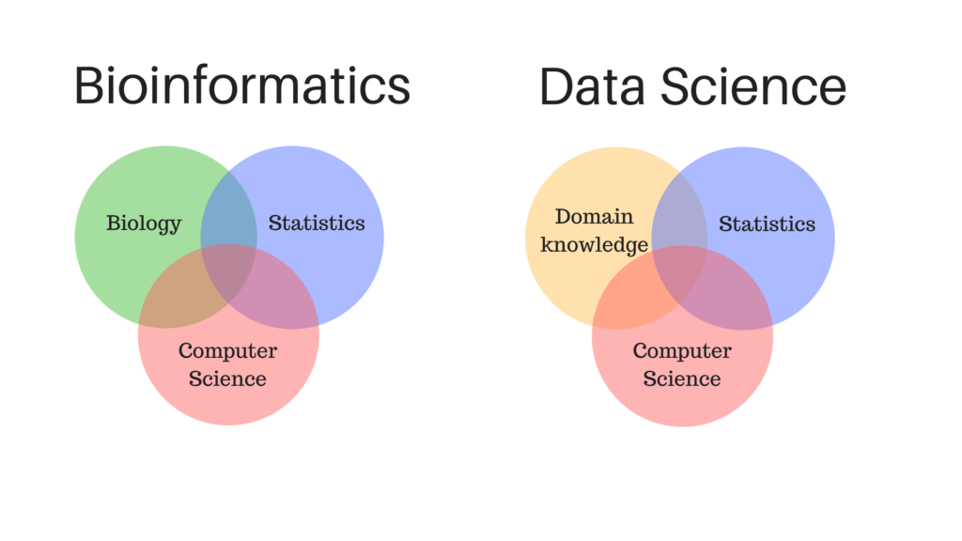
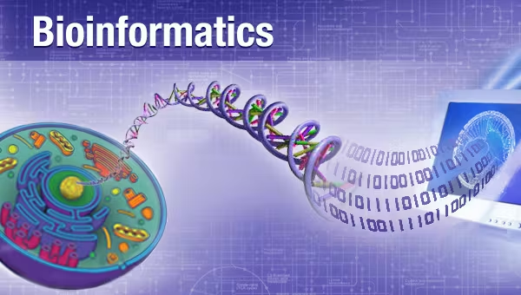
Introduction to Bioinformatics
Study program: Bioprocess Engineering
Elective Module (Wahlpflichtmodul)
9th October to 13th October
Responsible: Prof. Dr. Axel Blokesch, blokesch@fb2.fra-uas.de
by Pablo Riesgo-Ferreiro, TRON gGmbH
pablo.riesgoferreiro@tron-mainz.de
Day 2 - Session 2

Slide 2
Outline of session
Computational genomics pipelines - part II
Variant annotation
Single cell approaches
Proteomics
Replicate and reproduce
Evidences of the computational reproducibility crisis
FAIR principles
Open science, open source

Slide 3
Computational genomics pipelines - part II

Slide 4
NGS sequencer
FASTQ
Reference FASTA
alignment
SAM/BAM
variant calling
VCF

Slide 5
Computational genomics pipelines - variant annotation
Given a set of aligned reads (allowing mismatches!) we aim to identify
Challenges:
bla
bla
Applications:
bla
Figure 1 from https://doi.org/10.3390/app11020819 (Pös, 2021)
Standard input: VCF Standard output: VCF

Slide 6
Replicate and reproduce

Slide 7
Reproducibility versus replicability
Reproducibility versus replicability
Replicability. This is the act of repeating an entire study, independently of the original investigator without the use of original data (but generally using the same methods).
Reproducibility. A study is reproducible if you can take the original data and the computer code used to analyze the data and reproduce all of the numerical findings from the study. This may initially sound like a trivial task but experience has shown that it’s not always easy to achieve this seemingly minimal standard.
Definitions from American Statistical Association. Recommendations to Funding Agencies for Supporting Reproducible Research. 2017 https://www.amstat.org/asa/files/pdfs/POL-ReproducibleResearchRecommendations.pdf
A research study replicability can only be ensured by additional studies. But reproducibility can be assessed inmediately and it can be guaranteed in the scope of a single study.
We will focus here on computational reproducibility
NOTE: there is a lack of consensus about this terminology as discussed in (Plesser, 2018). Irrespective of the terminology we would like to focus on reproducibility as described above

Slide 8
Evidences of the computational reproducibility crisis

Slide 9
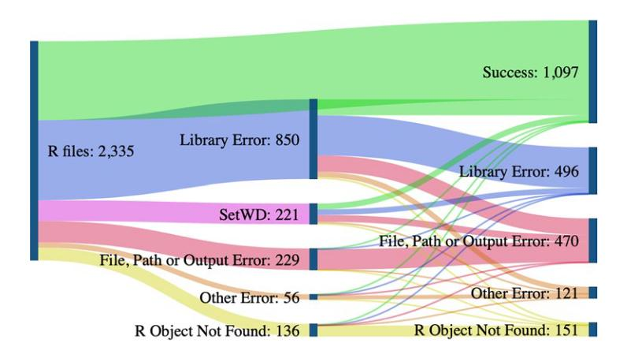
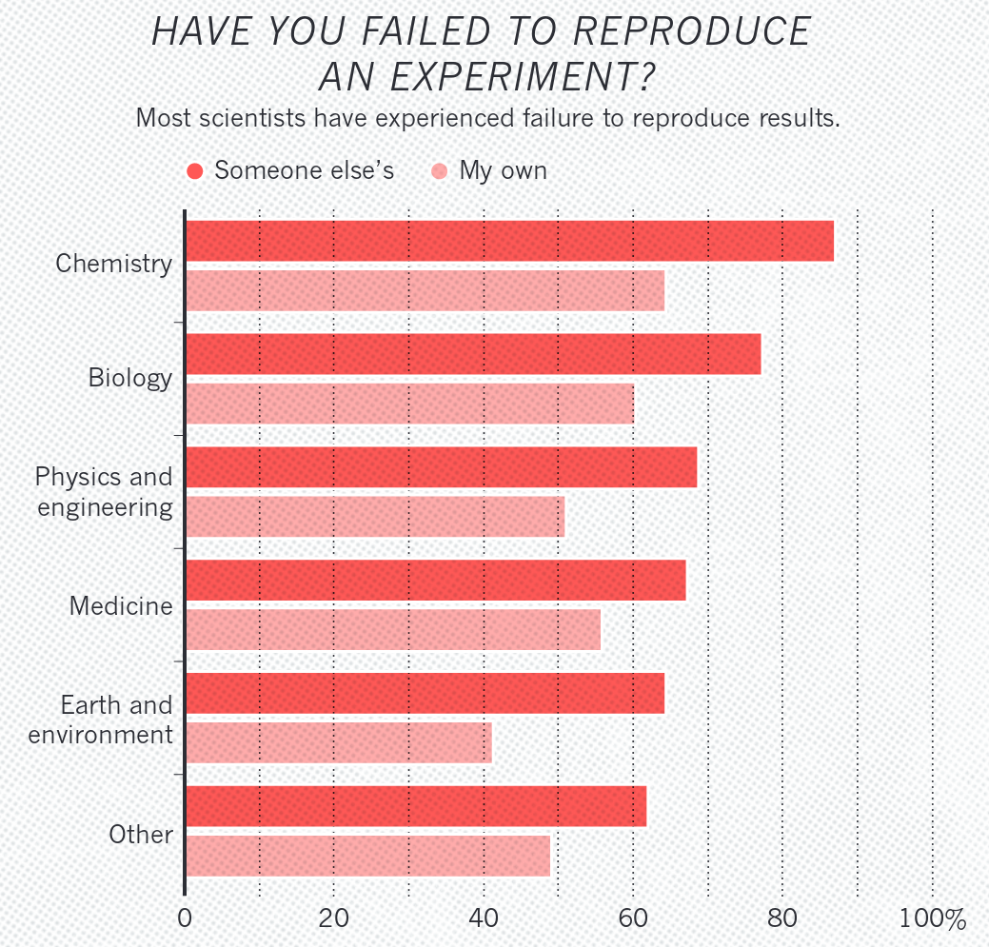
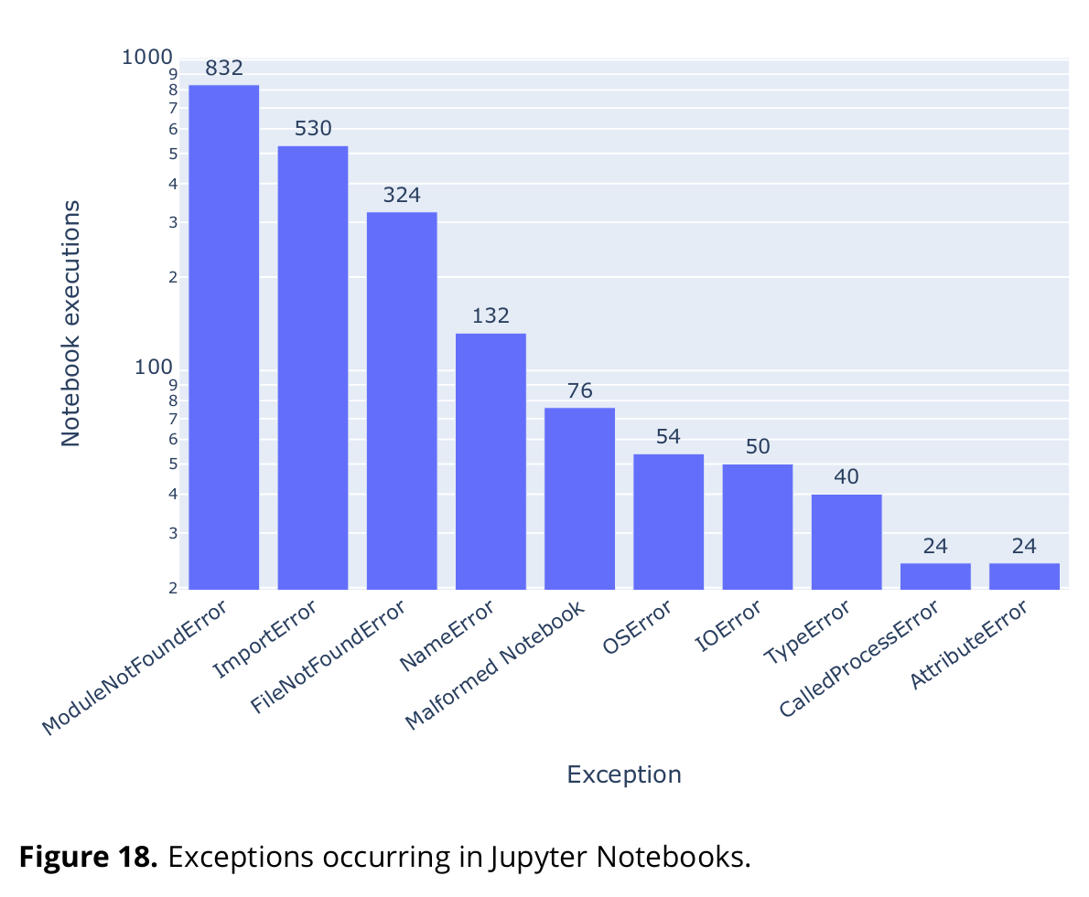
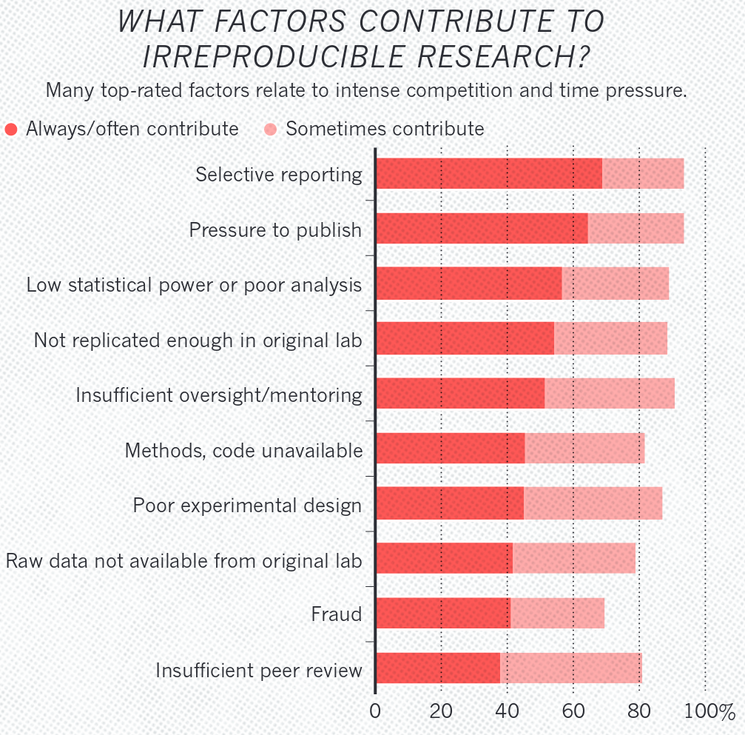
The reproducibility crisis
„Success rate and errors before and after code cleaning. To objectively determine the effects of code cleaning, we subset the results that have explicit “successes” and errors while excluding the ones with TLE values as the outcome. As a result, the count of files in this figure is lower than the total count.“ (Trisovic, 2022)
„2,265 (84.39%) notebooks resulted in exceptions due to several reasons.” (Samuel and Mietchen, 2022, p. 18)
Baker, M. 1,500 scientists lift the lid on reproducibility. Nature 533, 452–454 (2016).

Slide 10
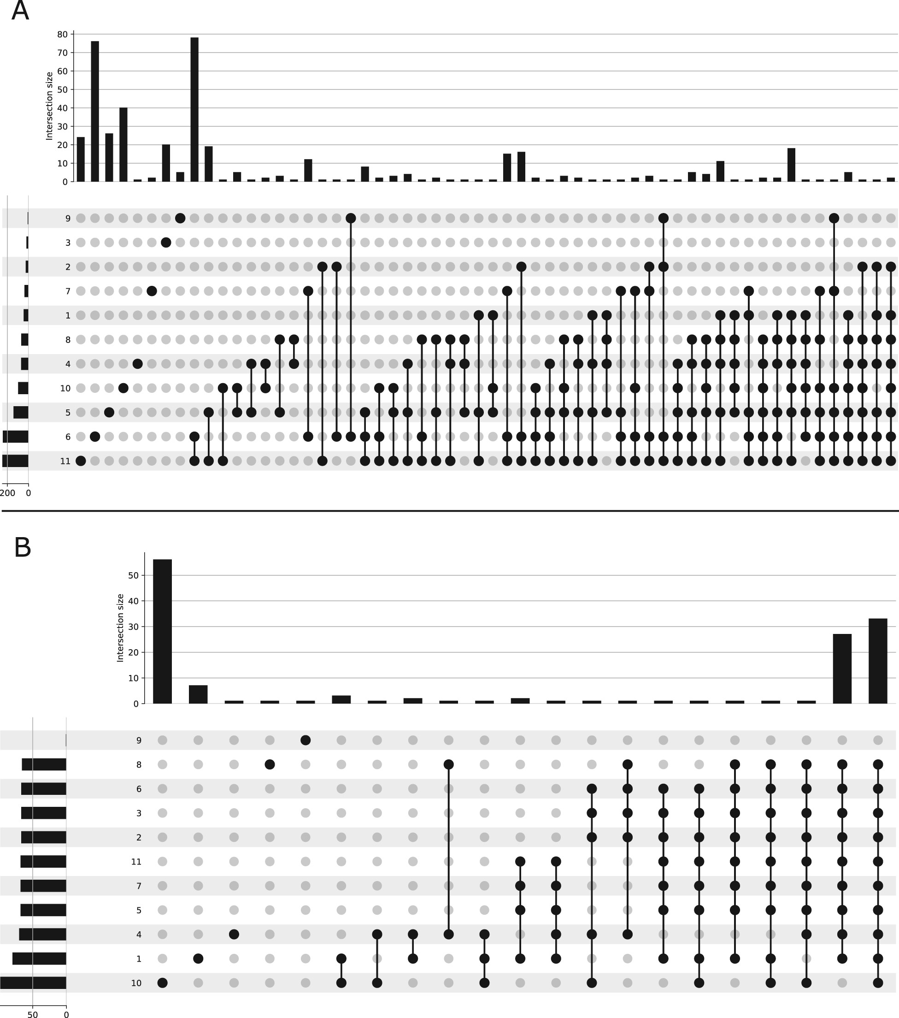
A community study on reproducibility on DGE
„Comparison of differentially expressed genes among 2022 groups using upset plots. Histograms on the top of each upset plot represent the number of differentially expressed genes in common (and specific) to the groups indicated by circles below. Below the histograms, each row corresponds to a group. (A) Upset plot representing the number of differentially expressed genes in common between groups using students own statistical analysis. (B) Upset plot representing the number of differentially expressed genes in common between groups using homogeneous statistical analysis.“ Cokelaer et al. Reprohackathons: promoting reproducibility in bioinformatics through training, Bioinformatics, Volume 39, Issue Supplement_1, June 2023, Pages i11–i20, https://doi.org/10.1093/bioinformatics/btad227

Slide 11
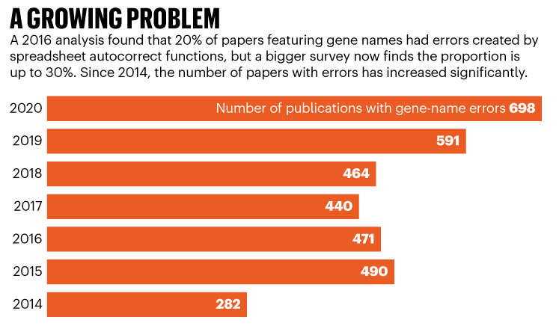
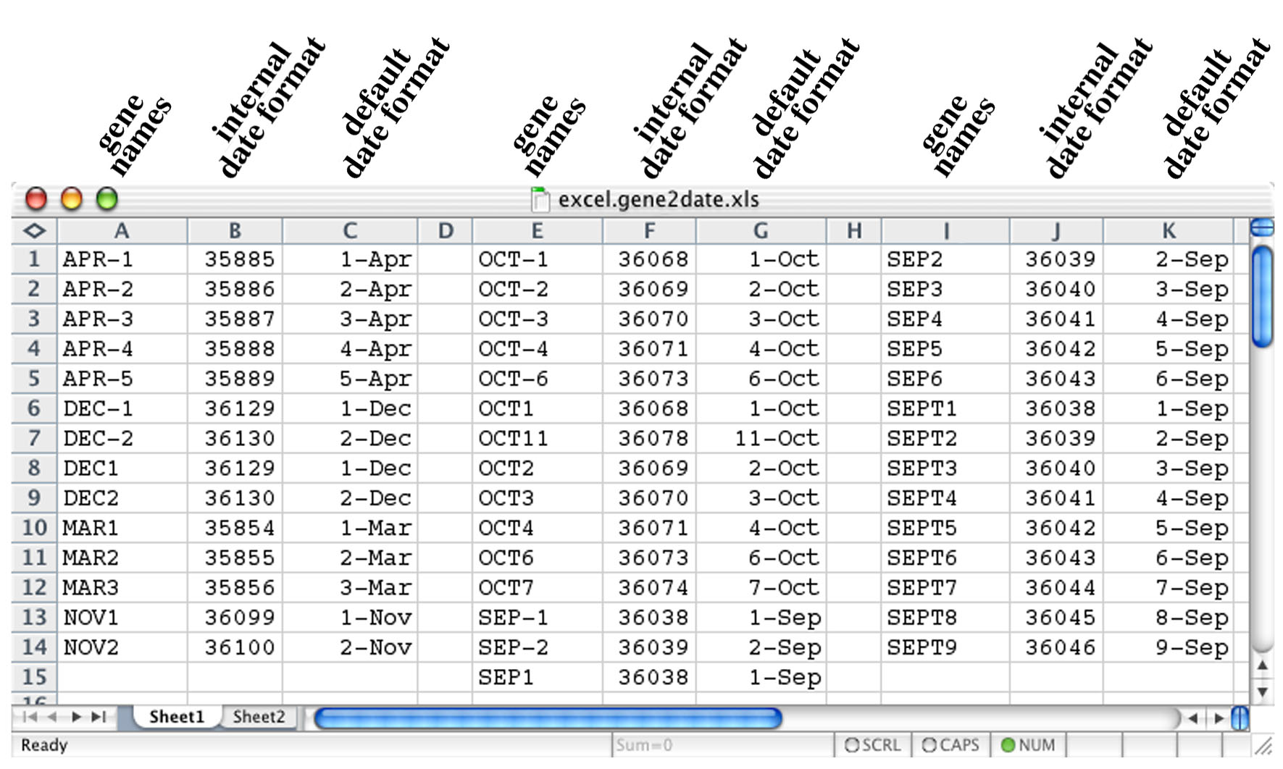
Favour flat formats (unfavour Excel...)
Favour flat formats (...unfavour excel)
„We screened 4321 Excel files deposited to NCBI GEO [3], identifying 574 files with gene lists and finding that 228 (39.7 %) of these contain gene name errors.“ Ziemann, M., Eren, Y. & El-Osta, A. Gene name errors are widespread in the scientific literature. Genome Biol 17, 177 (2016). https://doi.org/10.1186/s13059-016-1044-7
Source: https://www.nature.com/articles/d41586-021-02211-4
Source: http://blogs.nature.com/naturejobs/2017/02/27/escape-gene-name-mangling-with-escape-excel/

Slide 12
Computational reproducibility

Slide 13
The three levels of computational reproducibility
The three levels of reproducibility
Level 1. Being able to reproduce your own results in case of emergency
While you may think you comply with level 1, you need to consider change through time
Would reproducibility be ensured after some years have passed and probably servers have been replaced by new ones, software updated, etc.
Careful notes of every software dependency need to be taken
All operations on the data need to be documented
Level 2. Being able to reproduce your own results routinely
Automation plays a strong role to achieve level 2.
Every manual step is time consuming
Every manual step is error prone
Avoid manual steps
Level 3. Peers being able to reproduce your results
It has been shown that achieving level 3 increases citations (Piwowar, 2007)
These levels are defined in (Sandve, 2013)
Sandve et al., 2013. Ten Simple Rules for Reproducible Computational Research. 10.1371/journal.pcbi.1003285
Piwowar, 2007. Sharing Detailed Research Data Is Associated with Increased Citation Rate. 10.1371/journal.pone.0000308

Slide 14
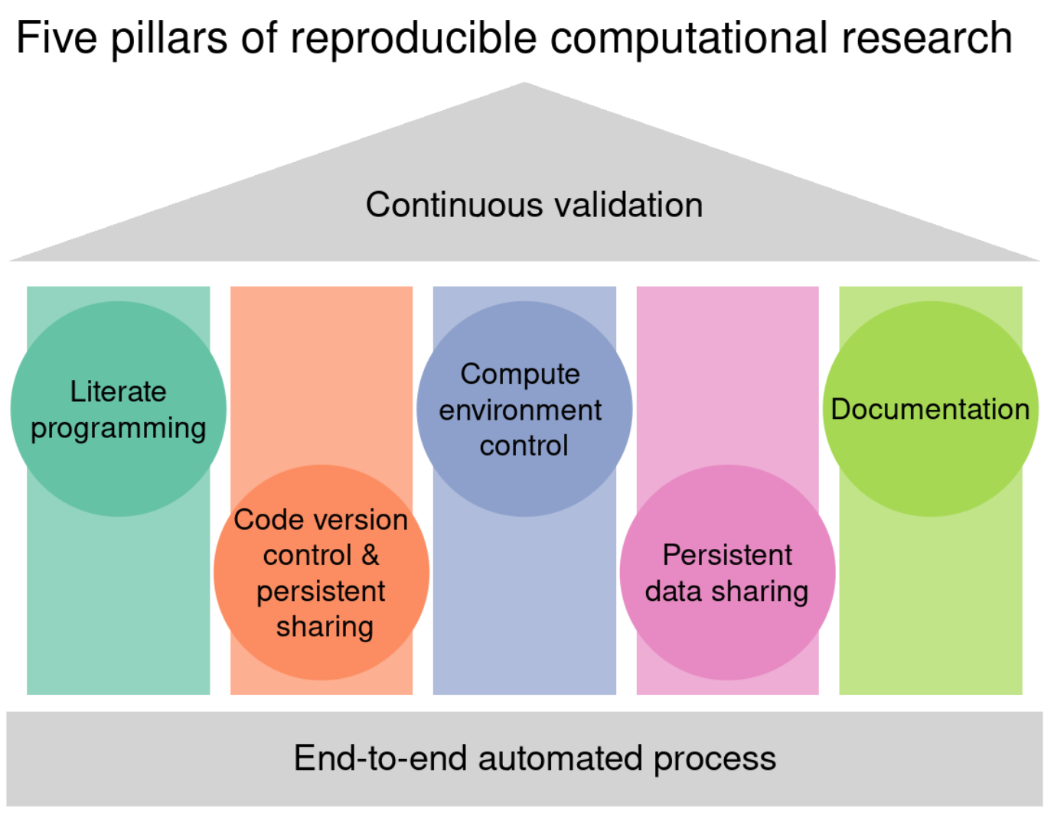
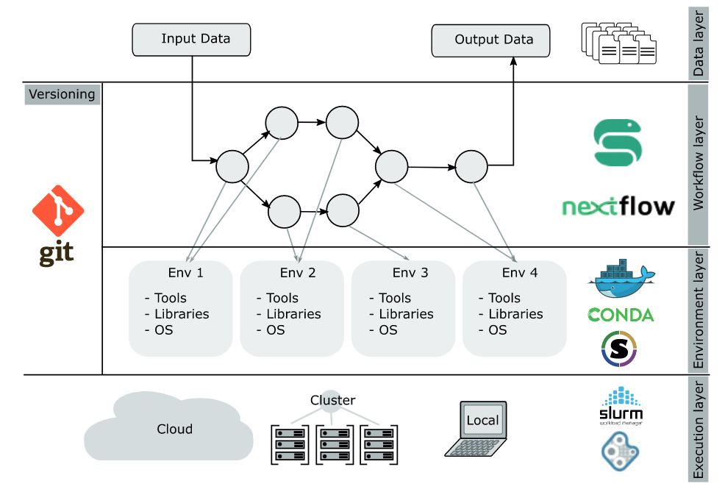
The five pillars of computational research
(Cokelaer, 2023) https://doi.org/10.1093/bioinformatics/btad227
(Ziemman, 2023) https://osf.io/4pd9n/

Slide 15
Data management
Store raw data + cleaned analysis-ready data + document data in spreadsheets
Data formats
Favour flat formats (ie: .txt, .csv, .tsv) for simple data and tables
Tidy data. Use long formats (ie: variables in columns, observations in rows), simple and easy to parse column names (Wickham, 2014)
Favour standard formats when available (eg: BAM, VCF)
Favour JSON or HDF5 formats for multidimensional complex formats with no defined standard
Document the data
Document raw data and „final„ data in spreadsheets
Metadata. Document how the data was obtained and what each variable means
Consistent folder and file naming protocol
Use a version control system
Avoid manual data manipulation steps (see next slide)
Store raw data behind plots

Slide 16
Code
Use code scripts to self-document and make every step reproducible
Shell scripts, makefiles or complex workflows. Anything executable as opposed to a documentation of manual steps
Favour figures created with code
Use open source tools freely available
Use software containers or virtual environments as a means of documenting software versions and enabling reproducibility in different platforms
Docker or singularity are the gold standard for reproducibility
Other solutions, although better than nothing, do not achieve full reproducibility
Aim at code and data reviews. „Four eyes principle“
Use some coding style guidelines
Linters are tools that analyse code as you write to flag programming errors, bugs, stylistic errors, and suspicious constructs
Use shorter lines and group code in blocks to facilitate reading (Martin, 2009)
Several popular coding guidelines exist for different languages (eg: tidyverse style guideline https://style.tidyverse.org/)
NOTE: code != software

Slide 17
Sharing results
Research compendium: data + code + software + products
Use data or code repositories to ensure long term availability (eg: GitHub). Other general purpose repositories also provide DOIs (eg: Dryad, Zenodo, FigShare)

Slide 18
FAIR principles

Slide 19
FAIR sharing
https://fairsharing.org/

Slide 20
Open science, open source

Slide 21
Bibliography and further reading
Wickham, 2014. Tidy data. 10.18637/jss.v059.i10
Alston et al., 2021. A Beginner's Guide to Conducting Reproducible Research. 10.1002/bes2.1801
American Statistical Association, 2017. Recommendations to Funding Agencies for Supporting Reproducible Research. https://www.amstat.org/asa/files/pdfs/POL-ReproducibleResearchRecommendations.pdf
Martin, 2009. Clean code: a handbook of agile software craftsmanship. ISBN: 9780136083238
Plesser, 2018. Reproducibility vs. Replicability: A Brief History of a Confused Terminology. 10.3389/fninf.2017.00076
Sandve et al., 2013. Ten Simple Rules for Reproducible Computational Research. 10.1371/journal.pcbi.1003285
Piwowar, 2007. Sharing Detailed Research Data Is Associated with Increased Citation Rate. 10.1371/journal.pone.0000308
Cokelaer, T., Cohen-Boulakia, S. & Lemoine, F. Reprohackathons: promoting reproducibility in bioinformatics through training. Bioinformatics 39, i11–i20 (2023).
Ziemann, M., Poulain, P. & Bora, A. The five pillars of computational reproducibility: Bioinformatics and beyond. Preprint at https://doi.org/10.31219/osf.io/4pd9n (2023).
Baker, M. 1,500 scientists lift the lid on reproducibility. Nature 533, 452–454 (2016).
Krafczyk, M., Shi, A., Bhaskar, A., Marinov, D. & Stodden, V. Scientific Tests and Continuous Integration Strategies to Enhance Reproducibility in the Scientific Software Context. in Proceedings of the 2nd International Workshop on Practical Reproducible Evaluation of Computer Systems 23–28 (Association for Computing Machinery, 2019). doi:10.1145/3322790.3330595.
Trisovic, A., Lau, M. K., Pasquier, T. & Crosas, M. A large-scale study on research code quality and execution. Sci Data 9, 60 (2022).
Samuel, S. & Mietchen, D. Computational reproducibility of Jupyter notebooks from biomedical publications. arXiv.org https://arxiv.org/abs/2209.04308v1 (2022).
Wilkinson, M., Dumontier, M., Aalbersberg, I. et al. The FAIR Guiding Principles for scientific data management and stewardship. Sci Data 3, 160018 (2016). https://doi.org/10.1038/sdata.2016.18
GO FAIR also regularly runs Metadata for Machines workshops

